Slide 1
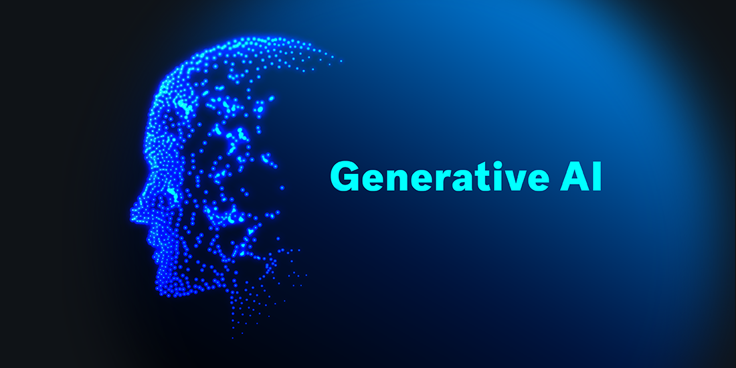

Slide 2
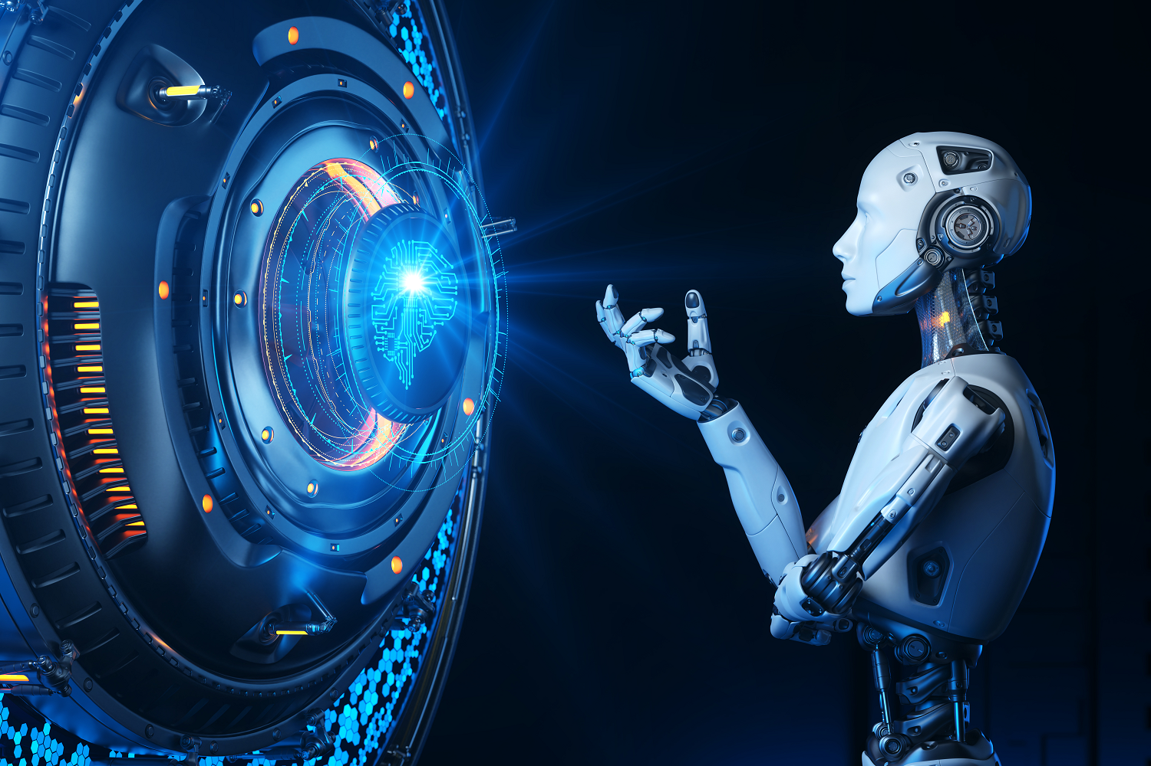
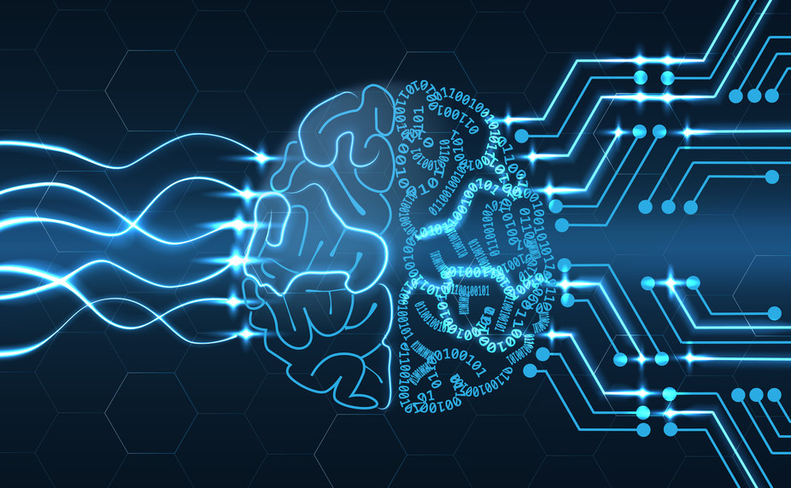
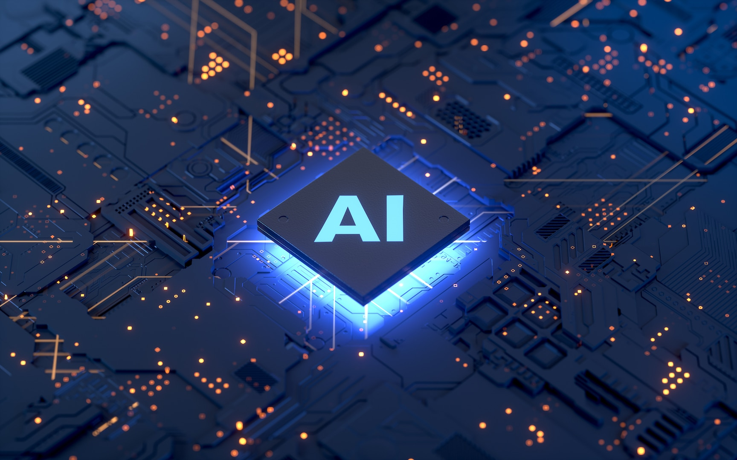
What is Artificial Intelligence

Slide 3

ARTIFICIAL INTELLIGENCE AI is a branch of computer science that deals with the creation of Intelligence agents, which are systems that can reason learn ,and act autonomously – Google
Facial Recogniton
Personalized feed on social media networks
Customized suggestions and advertisements
Route Planning
Search Engines

Slide 4


ARTIFICIAL INTELLIGENCE
Machine Learning
WHAT IS ARTIFICIAL INTELLIGENCE
Deep Learning
Discriminative
Generative AI
LLMs

Slide 5
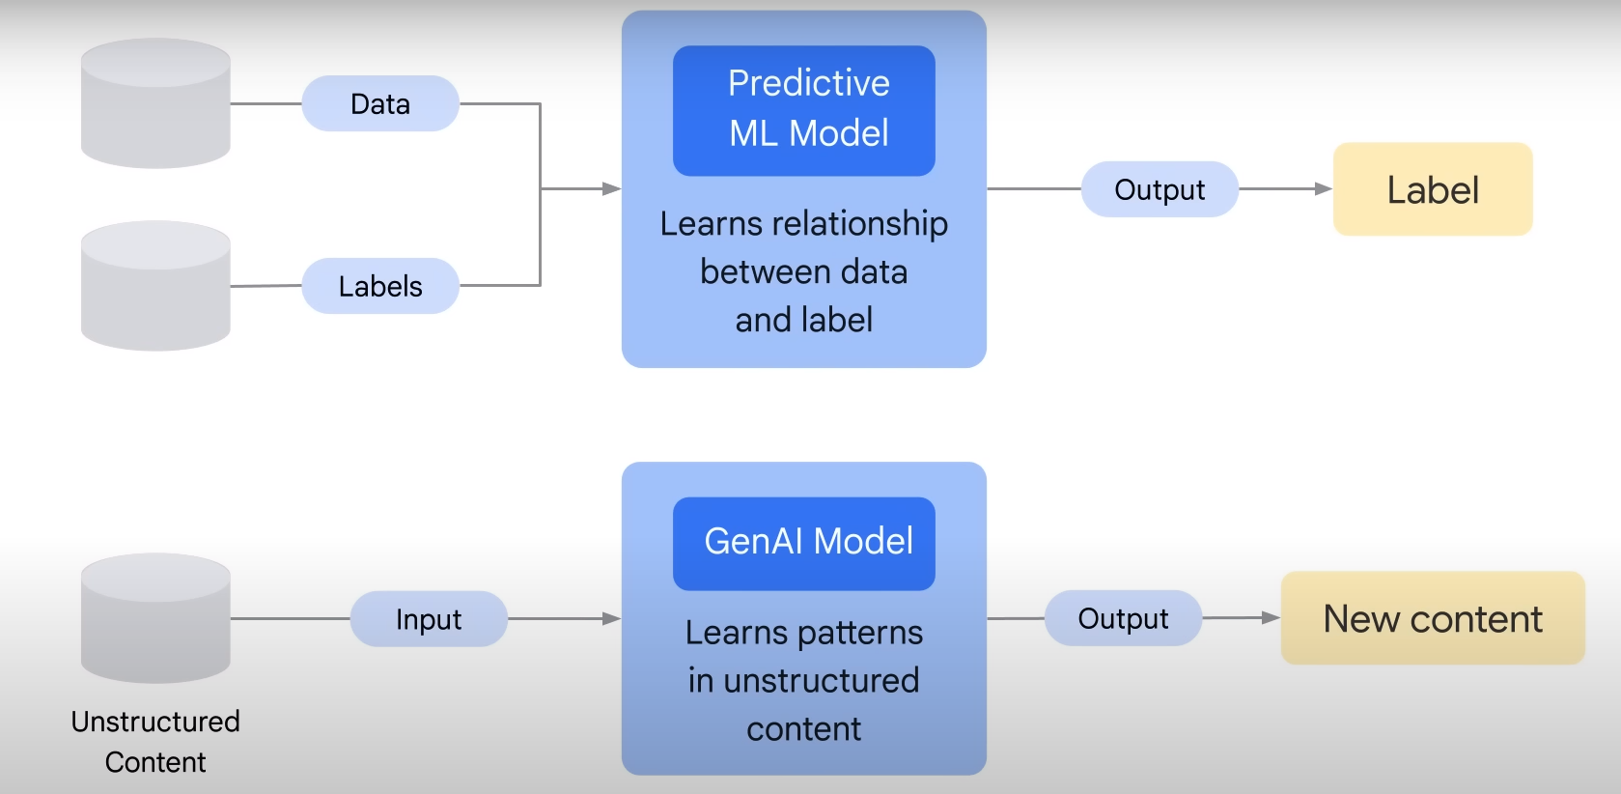
Difference

Slide 6
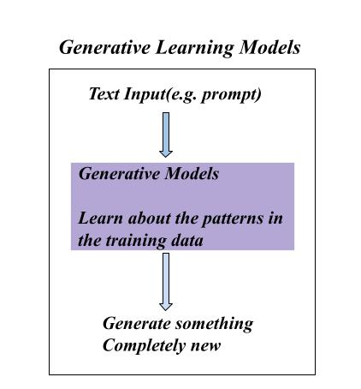
What is Generative AI Generative AI models can process various inputs like text, images, audio, video, and code to create new content across these same formats.

Slide 7
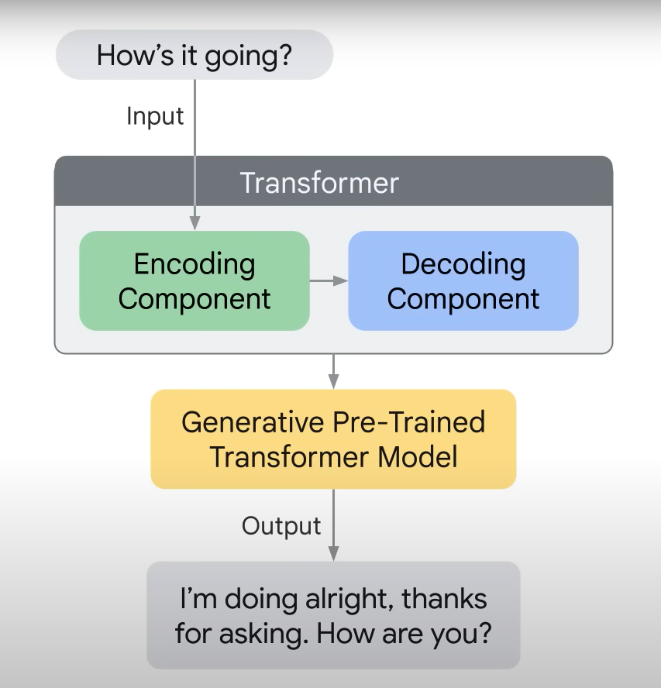
HOW GENERATIVE WORKS
Pre-Training:
Large Amount of Data
Billions of Parameters
Unsupervised Learning

Slide 8




GENERATIVE AI EXAMPLE
NO LABELS:
Give me the image of dog

Slide 9
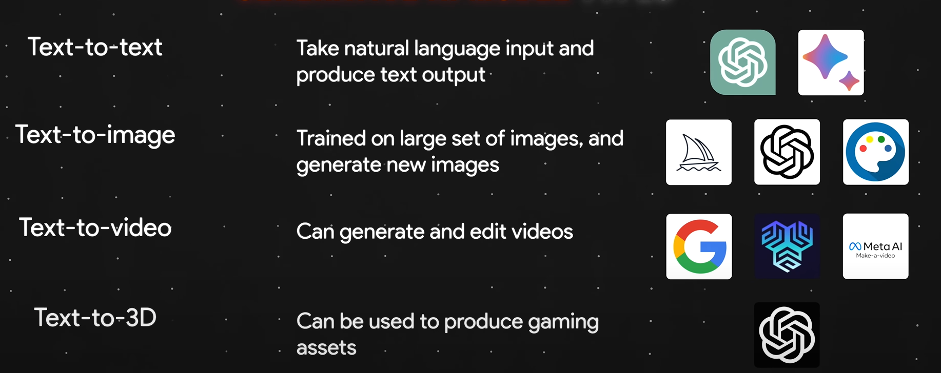
Generative AI Model Types

Slide 10
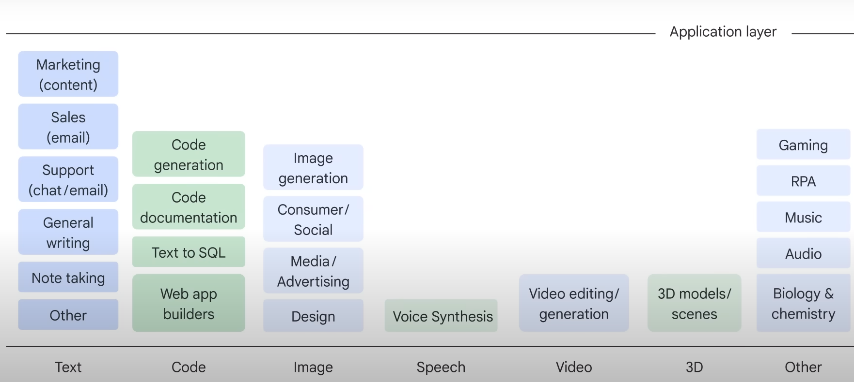
Landscape of Gen AI

Slide 11



LARGE LANGUAGE MODELS
LLMs are a specialized class of AI model that uses natural language processing (NLP) to understand and generate humanlike text-based content in response.
LLMS are Pre-trained with a large set of data and then fine-tuned for specific purpose.
LLMs are specifically designed for handling language-related tasks. Examples:

Slide 12

THANK YOU

